Slide 1
Introduction to Matplotlib
By Owais Ahmed Khan

Slide 2
What is Matplotlib?
Matplotlib is an open-source drawing library that supports various drawing types
You can generate plots, histograms, bar charts, and other types of charts with just a few lines of code

Slide 3
Pyplot
matplotlib.pyplot is a collection of functions that make matplotlib work like MATLAB.
Each pyplot function makes some change to a figure:
For instance:
creates a figure
creates a plotting area in a figure
plots some lines in a plotting area
decorates the plot with labels, etc.

Slide 4
Basic Component of the Charts:
The basic components of a Matplotlib graph include:
Figure: The entire area in which you plot your data. It acts as a container for all the other elements of the plot.
Axes: These are the actual plots or graphs where data is visualized. A figure can contain one or more axes. Axes can be thought of as a bounding box with ticks and labels.
Axis: These are the number-line-like objects that define the graph limits. They include tick marks, labels, and a title.
Title: A descriptive title for the graph.
X-axis label and Y-axis label: Labels that describe what each axis represents.
Data series: These are the actual data points or lines or bars that represent the information you are visualizing.
Legend: If there are multiple data series plotted on the same axes, a legend helps identify what each series represents.
Grid: An optional feature that adds grid lines to the plot, making it easier to read.

Slide 5
Line graph/ simple graph
Commonly used in data visualization for several reasons:
Trend Analysis: Line graphs are excellent for visualizing trends over time or across ordered categories. By connecting data points with lines, line graphs make it easy to see how the data changes over a continuous or ordered domain.
Comparison: Line graphs allow for easy comparison of multiple datasets or variables. By plotting multiple lines on the same graph, you can compare trends and patterns between different categories or groups.
Showing Continuity: Line graphs emphasize continuity in the data. They are particularly useful for displaying data that changes smoothly and continuously, such as stock prices, temperature variations, population growth, etc.

Slide 6
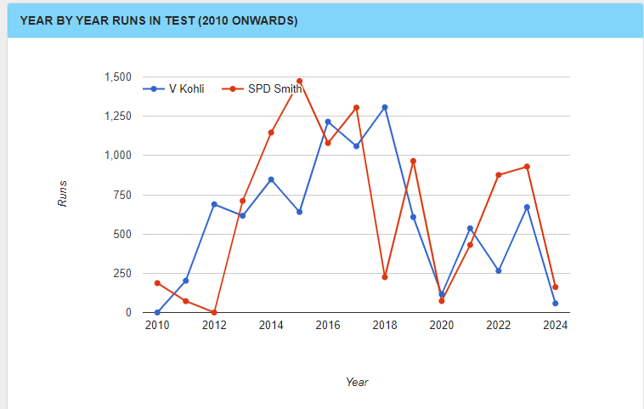
Class Task

Slide 7


